Slide 1
2025 Summer School on AI Technologies for Trust, Interoperability, Autonomy and Resilience in Industry 4.0
Júlio Costa
Erell Choulette
Raza Naqvi
(Group SIMU2)

Slide 2
Content
Learning Outcome
Web of Things (WoT);
Knowledge Graphs (KG);
Multi-Agent Systems (MAS);
Ai Trustworthiness and Responsable AI;
Hackhaton Implementation
Challenges
MAS Discussions

Slide 3

Web of Things (WoT)
The Web of Things aims to enhance the integration and interoperability of physical assets within the digital ecosystem. However, several challenges remain:
Standardization
Connectivity and Protocols
Interoperability
Synchronization
Usability: The design and deployment of WoT systems still face usability challenges, particularly in configuring, maintaining, and interacting with distributed devices for non-expert users.
Notes:
The Web of Things aims to enhance the integration and interoperability of physical assets within the digital ecosystem. However, several challenges remain:
Standardization: Physical devices often lack consistent standards, making integration difficult across manufacturers and platforms.
Connectivity and Protocols: A wide variety of communication protocols are used, leading to compatibility issues and hindering seamless device-to-device communication.
Interoperability: Achieving true interoperability between heterogeneous devices remains a core objective, requiring common data models, interfaces, and interaction patterns.
Synchronization: Coordinating the behavior of diverse sensors and actuators—especially those with differing update rates and latencies—presents technical complexity.

Slide 4
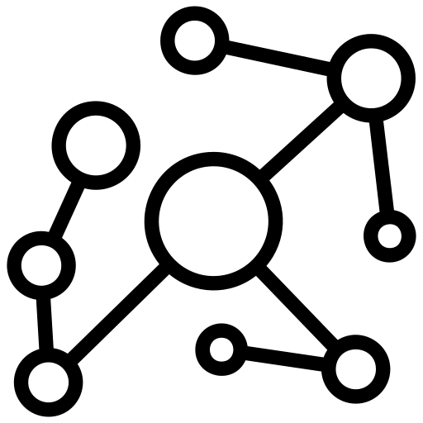
Knowledge Graphs
Knowledge graphs provide a structured way to represent and manage knowledge by organizing information as interconnected entities and their relationships.
Semantic Representation
Querying
Integration with the Web of Things (WoT): Knowledge graphs can serve as the semantic backbone of WoT systems. In particular, the hypermedia-driven framework enables middleware implementations that bridge the physical world (things) and semantic representations (knowledge graphs), facilitating discovery, interoperability, and reasoning across devices.
Notes:
Knowledge graphs provide a structured way to represent and manage knowledge by organizing information as interconnected entities and their relationships.
Semantic Representation: They capture things (entities), relationships, semantics, constraints, cardinalities, and other ontological elements, allowing machines to interpret data meaningfully.
Querying: Languages like SPARQL enable expressive querying and retrieval of knowledge from formal knowledge bases (ontologies).

Slide 5


Multi-Agent Systems (MAS)
Multi-Agent Systems enable the modeling of autonomous, interactive agents that operate within dynamic environments. A prominent framework for implementing MAS is JaCaMo, which integrates agents, environments, and organizational abstractions.
JaCaMo Framework: Combines Jason, CArtAgO and Moise.
BDI Paradigm (Belief–Desire–Intention)
Perception and Communication
Artifacts as Interfaces to the Physical World: In the context of the Web of Things, artifacts typically represent Things—physical or digital resources—which agents can observe or manipulate.
Notes:
Multi-Agent Systems enable the modeling of autonomous, interactive agents that operate within dynamic environments. A prominent framework for implementing MAS is JaCaMo, which integrates agents, environments, and organizational abstractions.
JaCaMo Framework: Combines three main components:
Jason: For programming agents using AgentSpeak (a language based on the BDI paradigm).
CArtAgO: For defining and managing artifacts, i.e., resources or "things" with which agents interact.
Moise: For modeling social and organizational structures.
BDI Paradigm (Belief–Desire–Intention):
Beliefs: Represent the agent’s current knowledge about itself and the environment.
Desires: Define the goals or objectives the agent aims to achieve.
Intentions: Describe the plans or actions the agent commits to in order to fulfill its desires.
Perception and Communication: Agents perceive changes in the environment and communicate with each other via messages, enabling coordination and cooperation.

Slide 6

AI Trustworthiness and Responsible AI
Ensuring that AI systems behave in a safe, fair, and reliable manner is central to the development of trustworthy and responsible AI.
Bias;
Explainability;
Transparency and Interpretability;
Addressing these concerns is crucial for deploying AI in high-stakes domains (e.g., healthcare, manufacturing, or autonomous systems), where unintended consequences can have significant real-world impacts.
Notes:
Bias: AI models can inherit or amplify biases present in training data, leading to unfair or discriminatory outcomes. Identifying, mitigating, and auditing such biases is essential to ensure equitable AI behavior.
Explainability: Many AI systems—especially deep learning models—function as black boxes. Explainable AI (XAI) seeks to make model decisions understandable to humans, enhancing trust, accountability, and debugging capabilities.
Transparency and Interpretability:
Transparency refers to the openness about how an AI system is designed, trained, and evaluated.
Interpretability is the extent to which a human can understand the reasoning behind a system's outputs. These properties are often lacking in complex models, posing challenges for verification, compliance, and stakeholder trust.

Slide 7
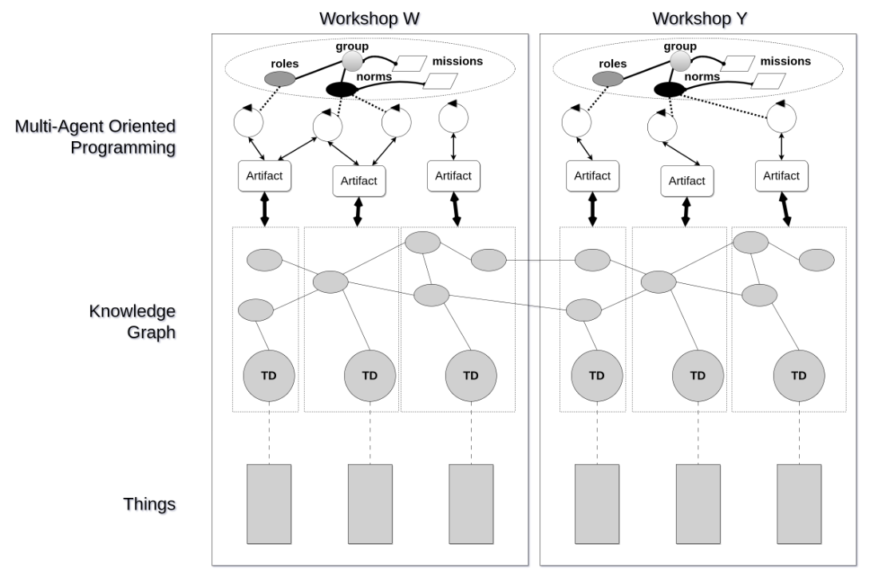

Hackthon Implementation

Slide 8
Challenges
Developing the MAS system;
System setup;
Internet and Server connection.

Slide 9
MAS Discussions
One agent for controlling the full process involving the workshops? one agent for controlling each workshop? several agents for controlling each workshop?
One environment structured in one or multiple workspaces? one or several artifacts? what is their usage interface (observable properties, events, actions)?
One or several organizations structuring, regulating and coordinating the agents so that they altogether realize the whole process?
Notes:
1 - One agent for controlling each Workshop
ConveyorWorkshop - Cup Provider is an Artifact
ConveyorWorkshop - Converyor is an Artifact
- Clamp is an Agent
- The tank is an Agent
- The Package Provider is an Artifact
2 - For this specific use case one environment for each Workspace, with several artifacts
3 – One organization

Slide 10
Thank you.
Júlio Costa – juliocosta@ipb.pt
Erell Choulette – e.choulette@mailo.com
Raza Naqvi – razisyed4@gmail.com
Due Duy Do – duc-duy.do@centralesupelec.fr
Nacira Abbas – abbasnacira@gmail.com

